Slide 1
LIFE/work balance
We have started a #LIFEworkbalance campaign and we need your help to complete our LIFE/work balance survey.
We hope to publish the results soon, so please give 15 minutes of your time to help us get a true picture of school life.
Want to be a part of this campaign? Take the survey on our website and share it with your colleagues!
© Classroom Secrets Limited 2019

Slide 2
Year 2 – Autumn Block 2 – Addition and Subtraction – Fact Families
About This Resource:
This PowerPoint has been designed to support your teaching of this small step. It includes a starter activity and an example of each question from the Varied Fluency and Reasoning and Problem Solving resources also provided in this pack. You can choose to work through all examples provided or a selection of them depending on the needs of your class.
National Curriculum Objectives:
Mathematics Year 2: (2C1) Recall and use addition and subtraction facts to 20 fluently, and derive and use related facts up to 100
Mathematics Year 2: (2C3) Recognise and use the inverse relationship between addition and subtraction and use this to check calculations and missing number problems
More Year 2 Addition and Subtraction resources.
Did you like this resource? Don’t forget to review it on our website.
© Classroom Secrets Limited 2018

Slide 3
Year 2 – Autumn Block 2 – Addition and Subtraction
Step 1: Fact Families
© Classroom Secrets Limited 2018

Slide 4
Introduction
Sort all the pairs of numbers that add to make 10.
5
6
8
3
1
0
4
10
5
9
7
2
© Classroom Secrets Limited 2018

Slide 5
Introduction
Sort all the pairs of numbers that add to make 10.
0
10
3
7
and
and
1
9
4
6
and
and
2
8
5
5
and
and
© Classroom Secrets Limited 2018

Slide 6
Varied Fluency 1
Which number sentence does not match the counters in
these ten frames?
15 + 5 = 20
5 + 15 = 20
20 – 5 = 15
15 – 20 = 5
© Classroom Secrets Limited 2018

Slide 7
Varied Fluency 1
Which number sentence does not match the counters in
these ten frames?
15 + 5 = 20
5 + 15 = 20
20 – 5 = 15
15 – 20 = 5
© Classroom Secrets Limited 2018

Slide 8
Varied Fluency 2
True or false?
If 17 + 3 = 20, then 20 – 17 = 3.
© Classroom Secrets Limited 2018

Slide 9
Varied Fluency 2
True or false?
True
If 17 + 3 = 20, then 20 – 17 = 3.
© Classroom Secrets Limited 2018

Slide 10
Varied Fluency 3
Use the tens frames to complete the missing numbers.
6 | + |  | = | 17
17 | – |  | = | 6
© Classroom Secrets Limited 2018

Slide 11
Varied Fluency 3
Use the tens frames to complete the missing numbers.
6 | + | 11 | = | 17
17 | – | 11 | = | 6
© Classroom Secrets Limited 2018

Slide 12
Varied Fluency 4
Write four number sentences to describe the fact family
shown in the part whole model.
16
6
10
© Classroom Secrets Limited 2018

Slide 13
Varied Fluency 4
Write four number sentences to describe the fact family
shown in the part whole model.
16
6
10
6 | + | 10 | = | 16
16 | – | 10 | = | 6
10 | + | 6 | = | 16
16 | – | 6 | = | 11
© Classroom Secrets Limited 2018

Slide 14
Problem Solving 1
Use the number cards below to find three fact families.
Write all of the possible number sentences.
6
8
9
5
7
10
 | + |  | = | 15
15 | – |  | =
© Classroom Secrets Limited 2018

Slide 15
Problem Solving 1
Use the number cards below to find three fact families.
Write all of the possible number sentences.
Fact family using 15, 10 and 5; fact family using 15, 9 and 6; fact family using 15, 7 and 8.
6
8
9
5
7
10
10 | + | 5 | = | 15
15 | – | 5 | = | 10
© Classroom Secrets Limited 2018

Slide 16
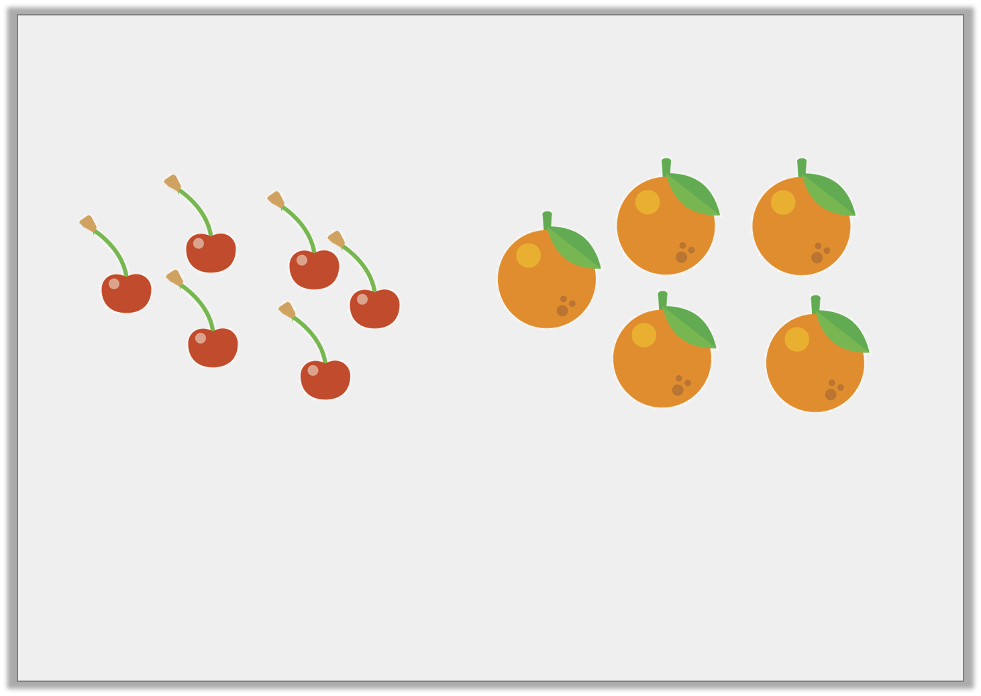
Problem Solving 2
Max counts 11 pieces of fruit in the bowl. Use the images to write two addition number sentences.
Using the addition sentences, write the subtraction sentences that would complete the fact family.
© Classroom Secrets Limited 2018

Slide 17
Problem Solving 2
Max counts 11 pieces of fruit in the bowl. Use the images to write two addition number sentences.
Using the addition sentences, write the subtraction sentences that would complete the fact family.
5 | + | 6 | = | 11
11 | – | 5 | = | 6
6 | + | 5 | = | 11
11 | – | 6 | = | 5
© Classroom Secrets Limited 2018

Slide 18
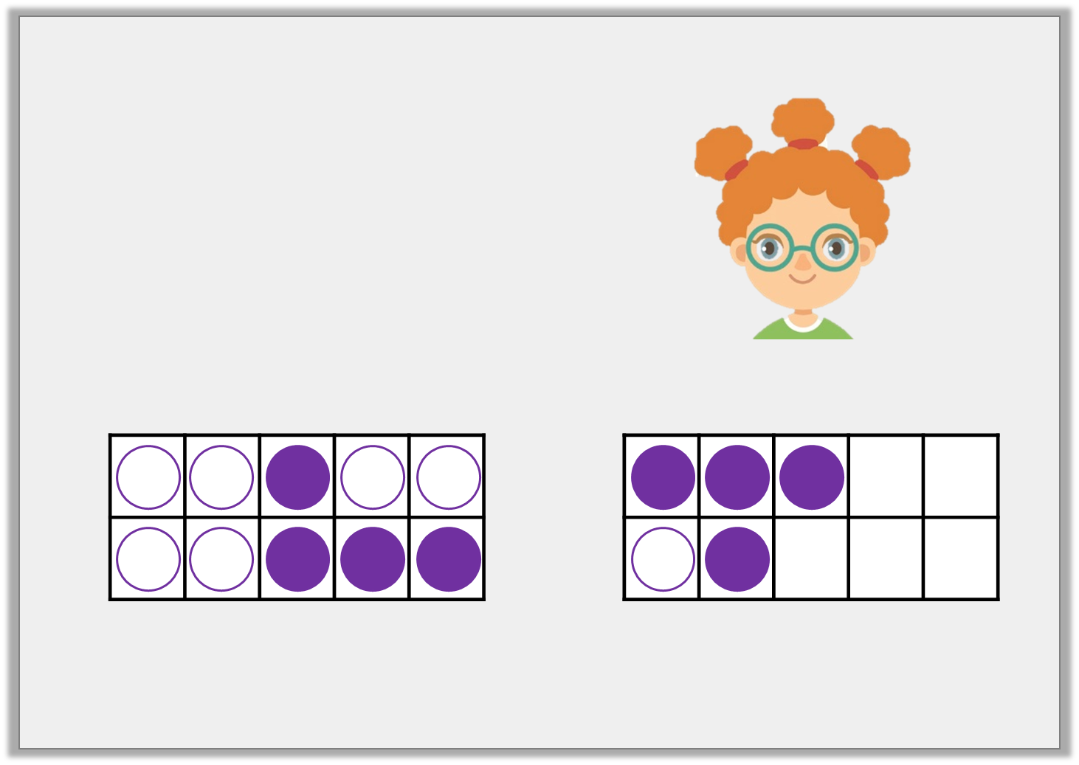
Reasoning 1
Amanda says,
I can use the numbers 14, 7 and 8 to write a fact family for these 10 frames.
© Classroom Secrets Limited 2018

Slide 19
Reasoning 1
Amanda says,
Amanda is incorrect. She should use…
I can use the numbers 14, 7 and 8 to write a fact family for these 10 frames.
© Classroom Secrets Limited 2018

Slide 20
Reasoning 1
Amanda says,
Amanda is incorrect. She should use 15, 8 and 7 to create a fact family.
I can use the numbers 14, 7 and 8 to write a fact family for these 10 frames.
© Classroom Secrets Limited 2018

