Slide 1
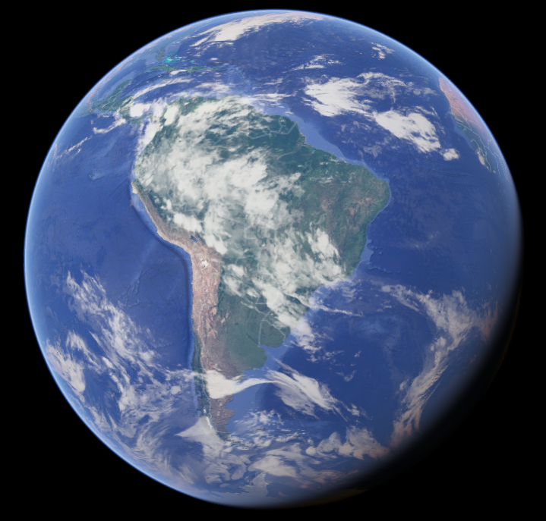
Key Stage 1 Geography

Slide 2
This is our world – Planet Earth

Slide 3
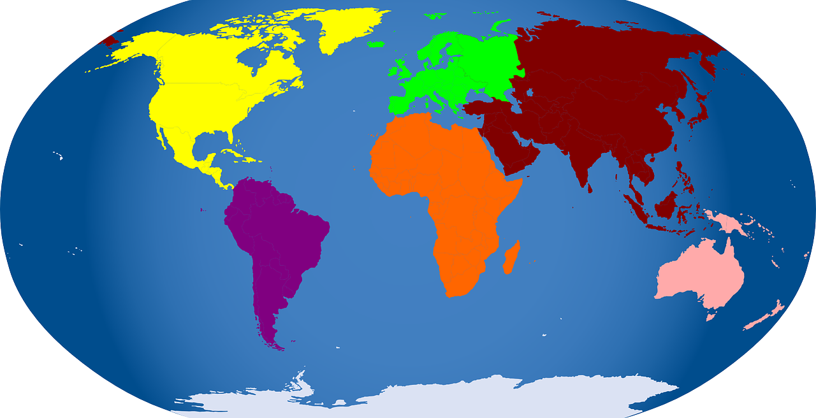
Planet Earth is divided into 7 different areas called continents.

Slide 4
The seven continents are:
Europe
North America
Asia
Africa
South America
Australia
Antarctica
Video about the continents

Slide 5
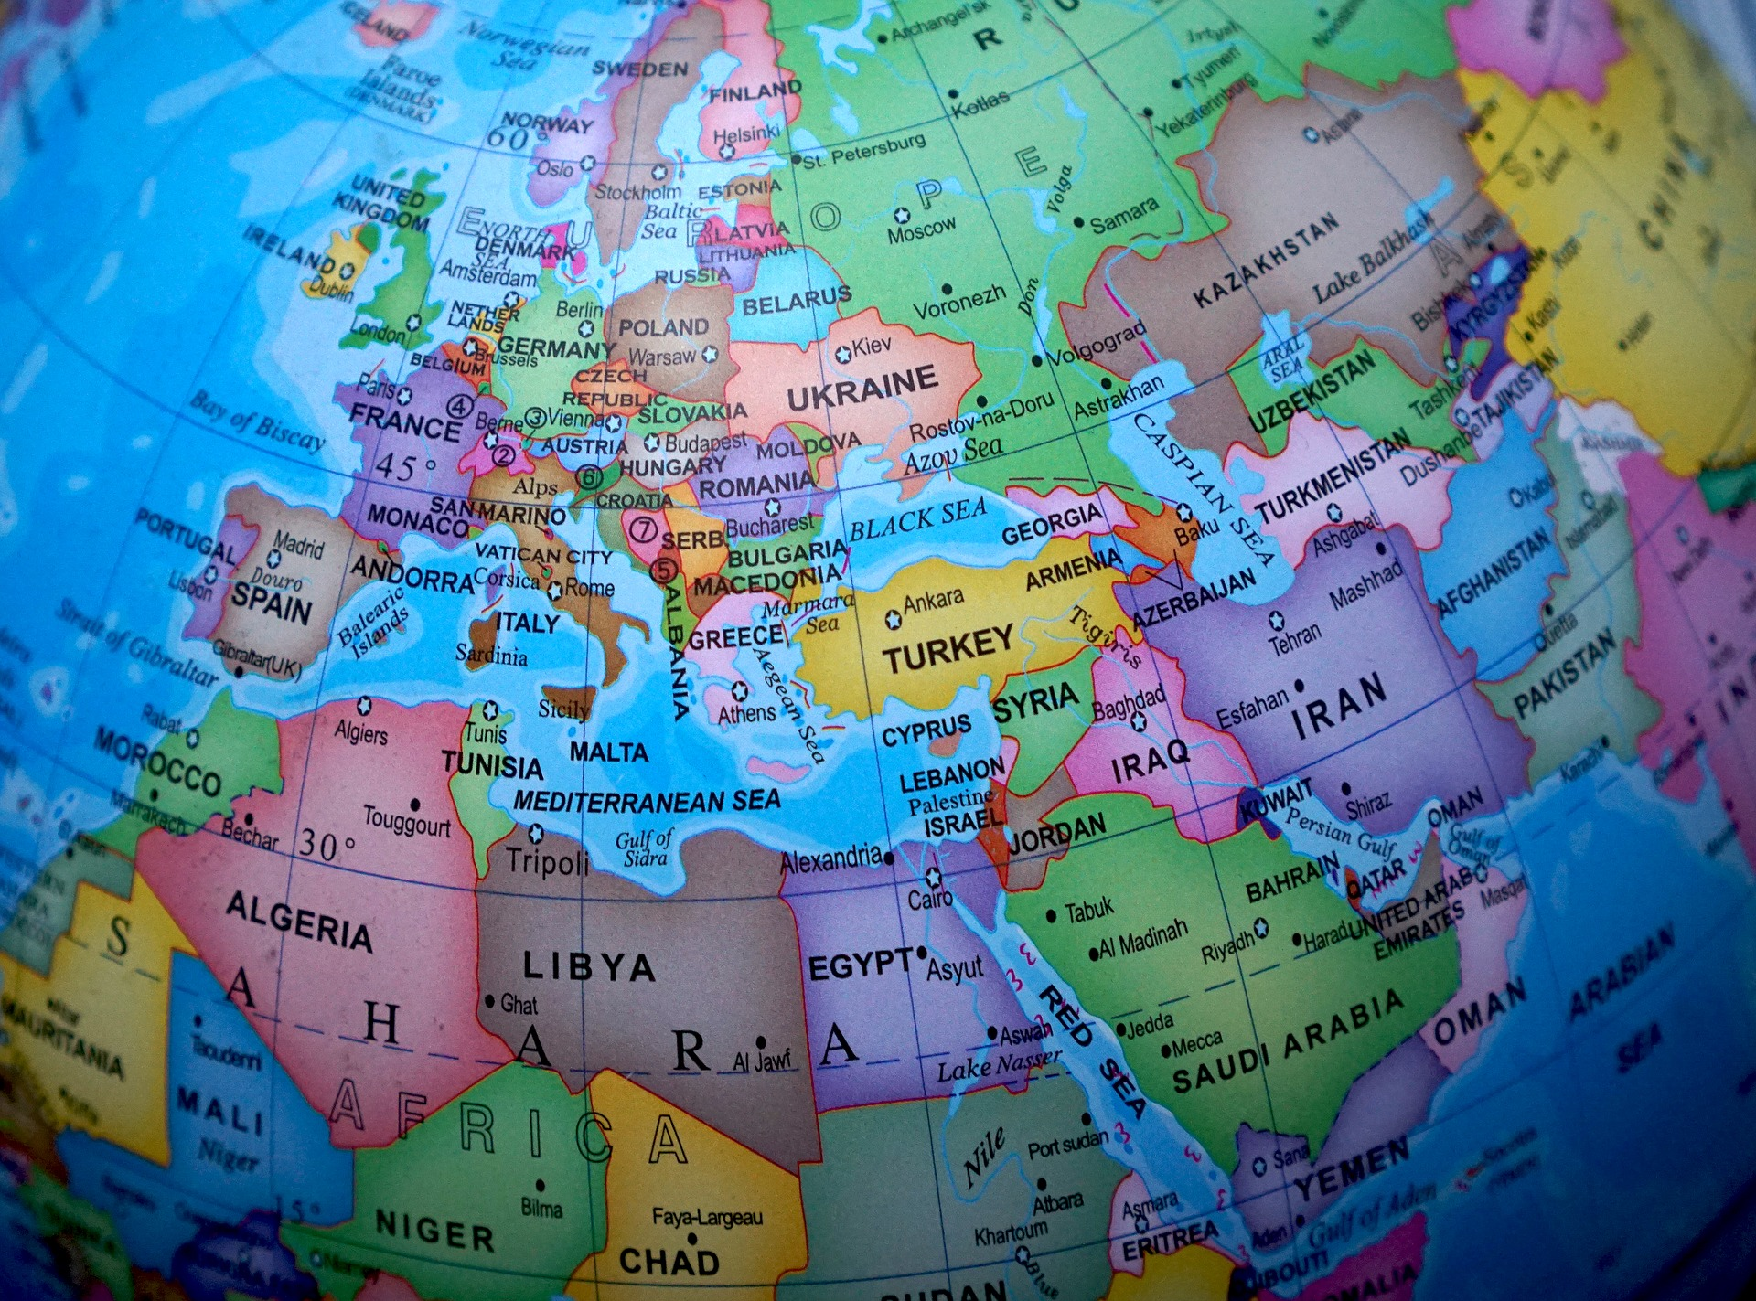
Each continent is then divided into countries

Slide 6
You can use a globe to look at all the different countries of the world.
All about the globe

Slide 7
We live in the United Kingdom (UK) which is a group of 4 different countries – England, Scotland, Wales and Northern Ireland.
Which one do you live in?

